Slide 1
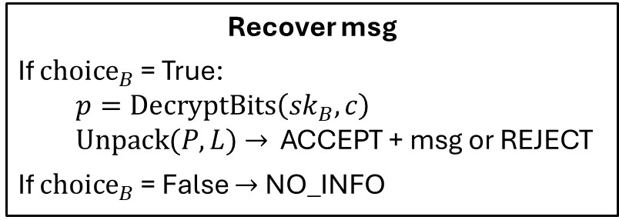
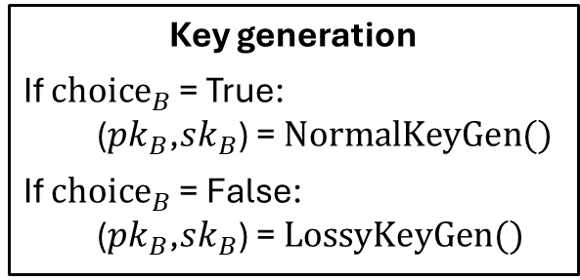



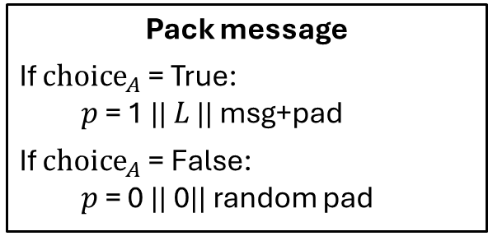

Alice
Bob
Initialize: $G$, $q$, $g$, $L$, $w$, $N$
Key generation
If ${choice}_{B}$ = True:
  ($pk_{B}$,$sk_{B}$) = $NormalKeyGen()$
If ${choice}_{B}$ = False:
  ($pk_{B}$,$sk_{B}$) = $LossyKeyGen()$
Public Identifier $sid$, $pk_{B}$
Pack message
If ${choice}_{A}$ = True:
  $p$ = 1 || $L$ || msg+pad
If ${choice}_{A}$ = False:
  $p$ = 0 || 0|| random pad
$sid$, $c$
$$c= EncryptBits\left(pk_{B},p\right)$$
Recover msg
If ${choice}_{B}$ = True:
  $$p=DecryptBits\left(sk_{B},c\right)$$
  $Unpack(P,L)$ $→$ ACCEPT + msg or REJECT
If ${choice}_{B}$ = False $→$ NO_INFO

